Slide 1



Opening European Funds
Anna Alberts Open Knowledge Foundation Germany

Slide 2
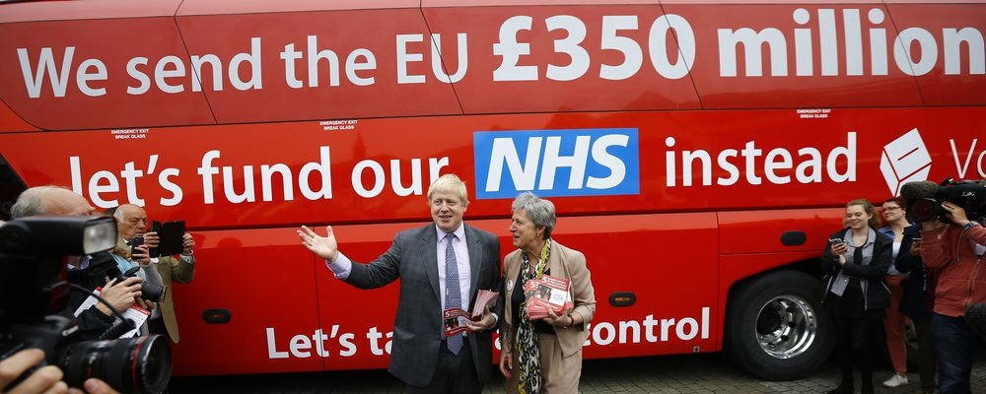
Money & the EU
Notes:
How Johson thinks we spend it
Although the European Union is often portrayed as a money-slurping, obscure, and corrupt machine.
It is surprisingly transparent about how it spends it’s money.
The EU spends most of its funds back in the Member States through a complex system of direct and indirect subsidies, grants and funds.

Slide 3
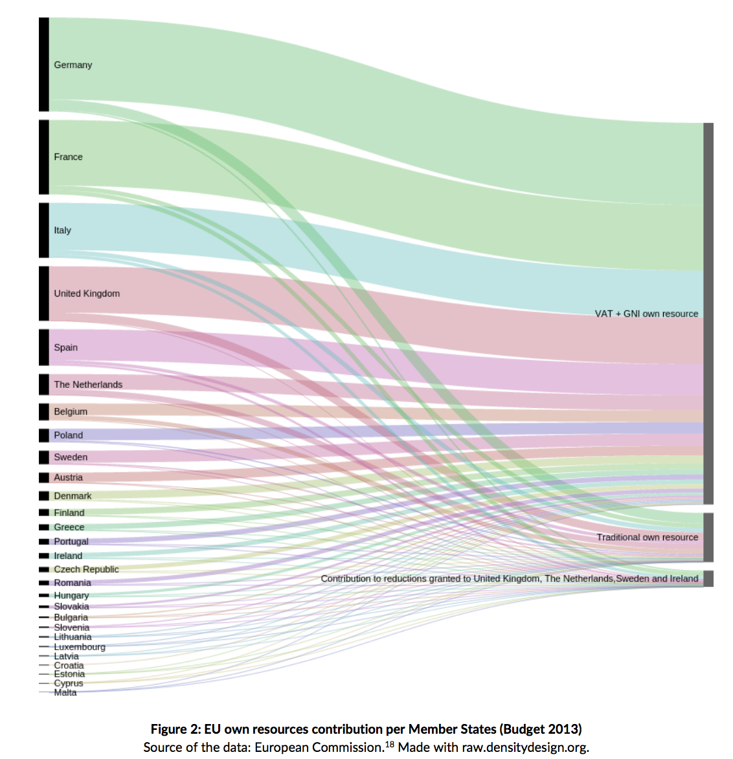
?
Notes:
Picture of slope graph to question mark.
National Politicians like to talk about how much we pay to the EU, the big question mark is how is this spend?
Although the European Union is often portrayed as a money-slurping, obscure, and corrupt machine.
It is surprisingly transparent about how it spends it’s money. The EU spends most of its funds back in the Member States through a complex system of direct and indirect subsidies, grants and funds. We just can’t find in one place how the member states spend that money again.

Slide 4
See also: http://openspending.org/resources/eu/notes.html (esp. for sources on figures)
European Financial Stability Fund (EFSF) 2011-2013: €141.2 bn (loans)
Other: Security and Citizenship: €15.7bn Global Europe: €58.8bn Administration: €62.6bn (2014-2020)
European Neighbourhood & Partnership Instrument (ENPI) 2007-2013: €11.2bn
(non-budget) European Development Fund (EDF) 2008-2013: €22bn
EuropeAid
EU Budget
European Agricultural Guarantee Fund (EAGF) 2007-2013: €320.055bn
Multiannual Financial Framework (MFF) 2014-2020: €960bn 2007-2013: €925.576bn
European Regional Development Fund (ERDF)
2014-2020: €187.4 bn 2007-2013: €201bn
Common Agricultural Policy (CAP)
EU Regional Policy (RP) 2014-2020: 2007-2013: €347bn
European Agricultural Fund for Rural Development (EAFRD) 2014-2020: 84.9bn 2007-2013: €96.3bn
Research and Technological Development
European Social Fund (ESF) 2014-2020: €84.4bn
2007-2013: €76bn
Common Fisheries Policy (CFP)
European Fisheries Fund (EFF) 2007-2013: €4.3bn
Cohesion Fund (CF)
2014-2020: €63bn 2007-2013: €70bn
Seventh Framework Programme (FP7) 2007-2013: €50.521bn
H2020:
EURATOM 2007-2013: €2.7bn
Development Cooperation Instrument (DCI) 2007-2013: €16.9bn
Notes:
It turns out that the EU spends most of its money back in the member states. The problem is that this is done through such a complex system of funds and policies and budgets that it is hard to know how this is spend.
Here is a not so clear graph of all the different posts in the Multi-Annual-Financial Framework.
(picture of the funds)
What makes this really problematic to trace is that these funds are all registered and managed by different agencies, institutes etc. either at the EU level or at member state level.

Slide 5
DG AGRI
DG MARE
DG REGIO
DG EMPL
Common Agricultural Policy (CAP)
Common Fisheries Policy (CFP)
Cohesion Fund (CF) 2014-2020: €63bn
European Regional Development Fund (ERDF)
2014-2020: €187.4 bn
European Social Fund (ESF) 2014-2020: €84.4bn
European Agricultural Guarantee Fund (EAGF) 2007-2013: €320.055bn
2014-2020: €
European Fisheries Fund (EFF) 2007-2013: €4.3bn
2014-2020: €7.4bn
European Agricultural Fund for Rural Development (EAFRD) 2014-2020: 84.9bn 2007-2013: €96.3bn
Notes:
As you see here, there are five major funds, CAP, the fisheries funds, the cohesion funds, and the ERDF, and finally the social funds. These are together called the ESIF and divided by different DGs, together with member states.
For the funds we focus on, DG Regio and DG Empl are responsible.

Slide 6
DG REGIO
DG EMPL
Cohesion Fund (CF) 2014-2020: €63bn
European Regional Development Fund (ERDF)
2014-2020: €187.4 bn
European Social Fund (ESF) 2014-2020: €84.4bn
Division per Region
Member State GNI Per Capita
<90 % EU av.
A: >90 % GNI EU av.
B: 75 % - 90 % GNI EU av.
C: < 60 % EU av.
Topics:
Innovation & Research
The digital Agenda
SME Support
Low Carbon
Management Authorities:
National/Regional
For example:
Ministry of Regional Development/Urban
Ministry of EU affairs
Development
Regional Agencies
Notes:
So the DGs divide the funds, based on strict rules per member state, or region.
In these partnership agreements, negotiated by the parliaments and the Commission, it is defined how much money and for which priorities the funds will be spend. Also different authorities overseeing this money are appointed, a certifying authority, and audit authority
This is the level of the EU. This data they have also put online on the website:
One of the biggest funds are the “European Structural and Investment Funds”. These funds are incredibly hard to trace because they are managed by different authorities on EU, member state and on regional level.

Slide 7
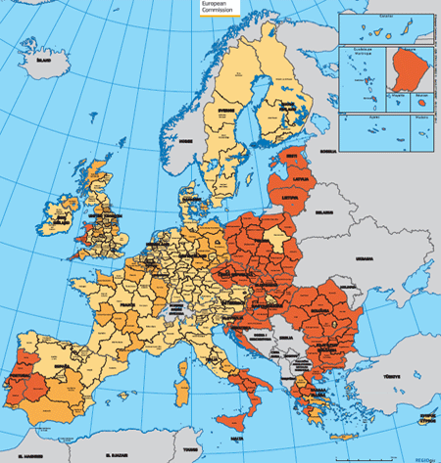
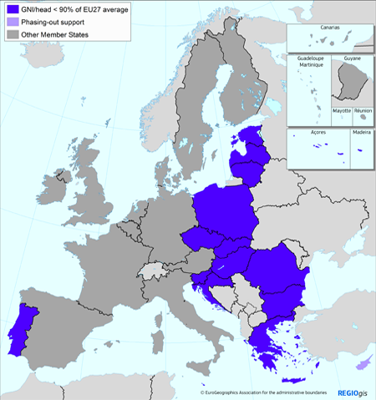
Notes:
The first division that the EU makes is whether a country is eligible for money under the Cohesion Funds, a country then needs to have less than the EU
One of the division being made in the policy is based on regions. There are three different regions:
A: >90 % GNI EU av.
B: 75 % - 90 % GNI EU av.
C: < 60 % EU av.
These regional classifications are used to decide which country is eligible for which funds and priorities, and the amount of co-financing they receive.
So, first of all, not all regions are eligible for money under all the themes, if you are a region in Souther Italy, you do not get money from the Cohesion Funds, but you are eligible for ERDF money and ESF money, with co-financing rates up to 80 %, meaning that the region only has to add 20 % to that subsidy. But for example, all regions in Poland, except for Warsaw are eligible for all subsidies on the highest co-financing rates.
You can clearly see this in the data on how to money is allocated that is put online by the EU.

Slide 8
Thematic objectives
In the 2014-2020 programming period, the European Structural and Investment Funds, in particular the European Regional Development Fund (ERDF), the European Social Fund (ESF) and the Cohesion Fund, will support 11 investment priorities, also known as thematic objectives:
1. Strengthening research, technological development and innovation
2. Enhancing access to, and use and quality of information and communication technologies (ICT)
3. Enhancing the competitiveness of small and medium-sized enterprises (SMEs)
4. Supporting the shift towards a low-carbon economy in all sectors
5. Promoting climate change adaptation, risk prevention and management
6. Preserving and protecting the environment and promoting resource efficiency
7. Promoting sustainable transport and removing bottlenecks in key network infrastructures
8. Promoting sustainable and quality employment and supporting labour mobility
9. Promoting social inclusion, combating poverty and any discrimination
10. Investing in education, training and vocational training for skills and lifelong learning
11. Enhancing institutional capacity of public authorities and stakeholders and efficient public administration
At the same time, the first four of these thematic objectives constitute key priorities for the ERDF, and a significant part of the investment will focus on these areas (between 50% and 80%, depending on the region’s level of development). The goal of these objectives is to focus regional policy funding on areas that deliver the highest benefits to citizens, creating synergies between the funded projects and avoiding an excessive fragmentation of funding.
Notes:
So, how does this work. Once every 7 years, the EU decides the budget and the themes and priorities are set for the budgetary cycle. We are currently in the 2014-2020 cycle. They have decided on the following 11 objectives for example for this year.
Once these objectives are set, it is up to the DGs to divide the funds and negotiate the partnership agreements

Slide 9
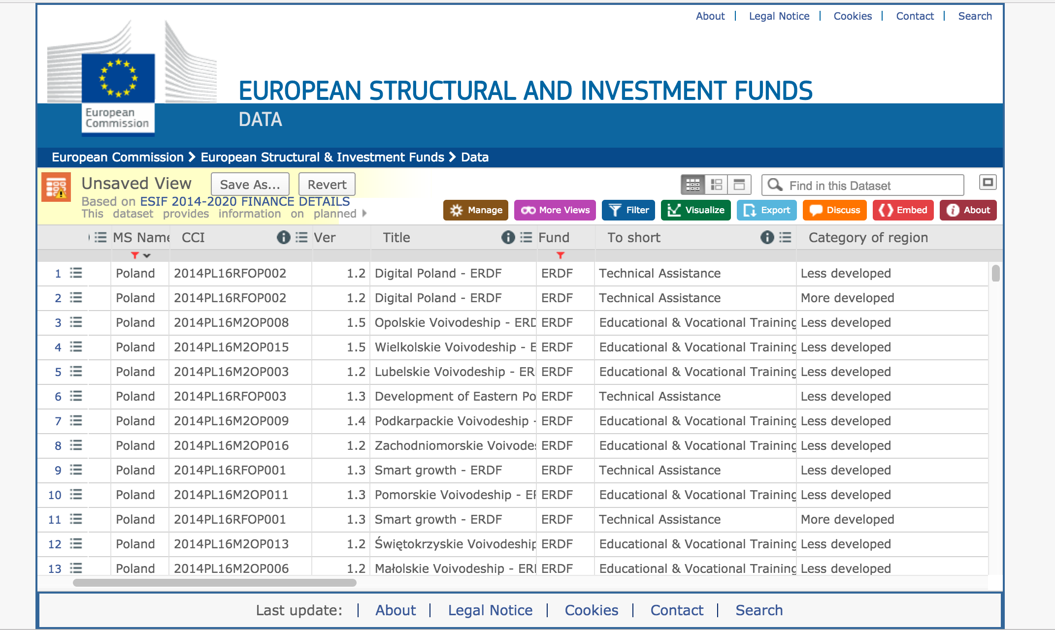
https://cohesiondata.ec.europa.eu/
Notes:
This is the Cohesion Funds website, and here we find the example of Poland in the data and the different funds, and priorities they are eligible for.

Slide 10
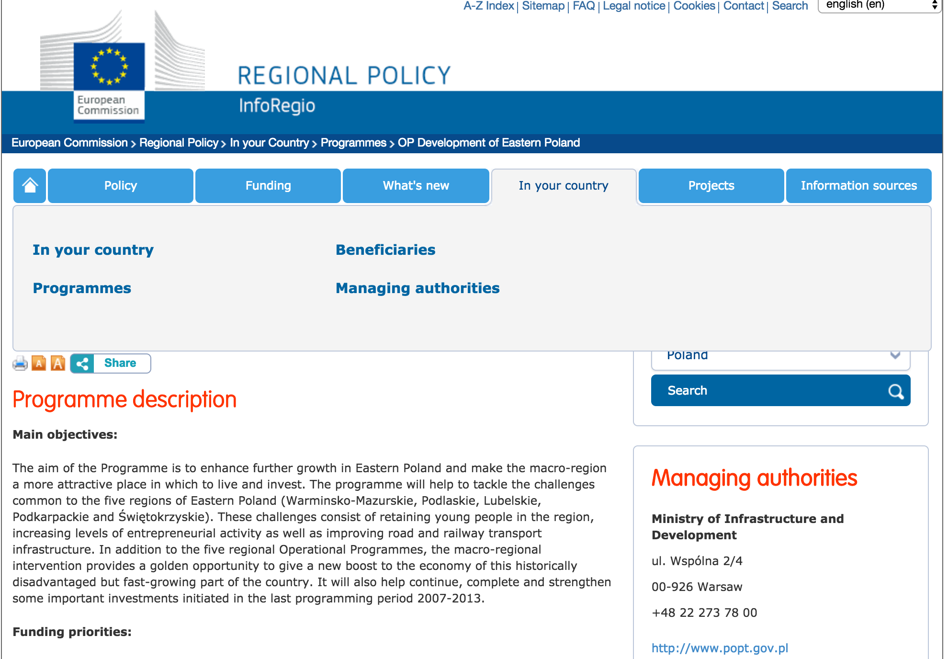
Regional Policy:
http://ec.europa.eu/regional_policy/en/
Programs:
http://ec.europa.eu/regional_policy/en/atlas/programmes/
Management Authorities:
http://ec.europa.eu/regional_policy/en/atlas/managing-authorities/
Local Websites with Beneficiary Lists:
http://ec.europa.eu/regional_policy/en/atlas/beneficiaries/
Glossary:
http://ec.europa.eu/regional_policy/en/policy/what/glossary/
Partnership Agreements: http://ec.europa.eu/contracts_grants/agreements/index_en.htm
Notes:
So how is it then decided how the money is spend in the regions.
First of all the member states enter into partnership agreements with the European Commission to decide on the precise allocation of the money. You can find these partnership agreements here:
Partnership agreement
Programs
Management Authorities
Local Websites
And we want to have it all

Slide 11
Partnership Agreements: http://ec.europa.eu/contracts_grants/agreements/index_en.htm
More Links:
Partnership Agreements:
http://ec.europa.eu/contracts_grants/agreements/index_en.htm
The Regulation on Structural Funds:
http://eur-lex.europa.eu/legal-content/EN/TXT/PDF/?uri=CELEX:32013R1303&from=EN
The Regulation on the Cohesion Funds:
http://eur-lex.europa.eu/legal-content/EN/TXT/?uri=CELEX%3A32013R1300
Notes:
If you want to know the nitty gritty behind all this: these are the links to the two regulations defining the rules around the ESIF and the Cohesion Funds. If we have time, we will soon do another talk on that. Or if there are EU law specialist amongst you, do contact us.
Another much more exsible and handy dandy link is the link to the glossary, you can find that here.

